Slide 1
USSVI Appalachian Base Membership Meeting
18 APR 2026 1400 HRS
AmVets Post 5, Bristol, VA

Slide 2
Agenda
Member Sign-in
Call to Order
Zoom Protocols
Moment of Silence
Invocation
Pledge of Allegiance
Reading of the USSVI Creed
Tolling of the Boats
Introductions
  USSVI Officials
  New Members
  Guests
Ice Breaker (15 minutes)
Adoption of Minutes
  Action Item Review
Adoption of Treasurer’s Report
Announcements
Correspondence
Reports
  Binnacle List
  Membership
  Program
  Fundraising
  Storekeeper
  Newsletter
  Web/Media
Break (10 minutes)
Old Business
New Business
Good of the Order
Open Floor
Benediction
Adjourn

Slide 3
Moment of Silence
Prisoners of War (PoW)
Missing in Action (MiA)
On Eternal Patrol:
  Those that lost their lives defending our nation while serving in the US Submarine Force
  Those that lost their lives defending our nation while serving in Epic Fury

Slide 4
Invocation
Eternal Father:
We humbly approach You with our petition for blessings upon our nation, military, navy, submarine force, and veterans. Guide our leaders into Your wisdom that they may serve Your mission. Enable the United States to be a blessing to all the other nations, promoting peace and the love You have shown toward us. And when we falter, we ask for Your great mercy, redirecting us on Your path. We thank you for the liberties we enjoy and the privilege to have served in protecting them. In Your holy name we pray. Amen!

Slide 5
USSVI Creed
The purpose/creed of USSVI is to perpetuate the memory of our shipmates who gave their lives in the pursuit of their duties while serving their country; that their dedication, deeds, and supreme sacrifice be a constant source of motivation toward greater accomplishments; and, to pledge loyalty and patriotism to the United States of America and its constitution.
In addition to perpetuating the memory of departed shipmates, USSVI shall provide a way for all Submariners to gather for mutual benefit and enjoyment. Our common heritage as Submariners shall be strengthened by camaraderie. The USSVI supports a strong U.S. Submarine force.
The organization will engage in various projects and deeds that will bring about the perpetual remembrance of those shipmates who have given the supreme sacrifices. The organization will also endeavor to educate all third parties it comes in contact with about the services our submarine brothers and sisters performed and how their sacrifices made possible the freedom and lifestyle we enjoy today.

Slide 6



Announcements
Base Web Site: https://USSVIAppalachianBase.org/
Base Facebook Group: https://www.facebook.com/groups/2022215555028032
US Submarine Force Strength

Slide 7
Correspondence
New USSVI Web Site: USSubVets.org or USSVI.org
Secure Message Scam – From Tim Carlisle (National Sr. Vice Commander and CTO)
Shipmate Fire Victim – GoFundMe: www.gofundme.com/f/rebuilding-after-the-fire-support-our-friend-the-hallidays

Slide 8

Old Business
Remote Meeting Technology Deployment – Zoom
Appalachian Base Logo
  Committee Formed Last Meeting
  Vote on Logo
Appointments:
  Membership Chair: Brian Rieck (Vice Commander)
  Logo Chair: Brian Rieck (Vice Commander)
  Logo Committee: Gil Kaelin, Jim Long
  KAP(SS)4KID(SS) Chair: Gary Christopher
  Web/Media Master: Alex Price (co-worker with Brian Rieck)

Slide 9

Old Business
Membership Committee – Volunteer with Vice Commander
  Recruiting Events – Partner or Schedule Events (e.g., Veteran Fair, Appalachian Fair, VA)
  Recruiting Items – Table Sign/Cover, Tent, Swag, Certificate, Challenge Coins
Programming Committee – Volunteer with Secretary
  Charity – USSVI Foundation, KAP(SS)4KID(SS), Boat Sponsorship
  Community Engagement – Monuments at Veteran Memorials, Parades, Schools
  Base Activities – Events/Venues, Cadence, Wives’ Involvement
  Membership Recognition – Rickover Club, Holland Club, Sailor of the Year
Fundraising Committee – Volunteer with Treasurer
  Raffles, Silent Auction, 50/50
  Meals – Bring in prepared food and serve (sell tickets), Base activity charges
  Advertising, Donations

Slide 10
Old Business
Volunteers Needed (see Vice Commander):
  Chief of the Base (CoB)
  Newsletter Editor
  Parliamentarian
Bank Account Opened – Eastman Credit Union, Gray, TN
Base Dues are Due! Grace period ends 31 MAY
  Pay Treasurer or send to base address:
      USSVI Appalachian Base
      c/o Treasurer
      830 Minga Road
      Kingsport, TN 37663
  Checks Payable To: USSVI – Appalachian Base
  Transfers – Update Primary and (optionally) Dual Membership Bases Online

Slide 11

New Business
Meeting Days/Times
  Next Meeting Scheduled for 09 MAY – Mother’s Day weekend
    Suggestion was to move to Third Saturday in May
  Second Saturday works in June to avoid Father’s Day
  Looking further, second Saturday works rest of year
Interest in Veteran Service Officer (VSO)/Benefit Advisor Session
  American Legion Post 255/VFW Post 4933 VSO – Cecil Carter
  Special Session or Invitation to Regular Meeting

Slide 12
New Business
Fundraising Limitations
  TN: NOT Registered with State as Foreign Entity and Charitable Organization ($600)
    Cannot raise funds from general public
    No games of chance allowed (e.g., 50/50)
  VA: NOT Registered with State as Foreign Entity
    Cannot raise funds from general public
    Fundraising and gaming subject to audit ($20K)
  USSVI (and the base) are 501(c)(19) with less than 90% wartime veterans
    Contributions to the base are NOT tax deductible
Possible Work Arounds
  VFW Post 4933 (base host) is 501(c)(19) with 100% wartime veterans – tax deductible contributions
    VFW Post 4933 is Registered with TN as Corp. and Charitable Organization
    Contributions may be passed through VFW Post 4933 to allow contributors’ tax deductions
  USSVI Foundation is 501(c)(3) and Registered with some states for fundraising with the general public
    Experimental: Use Foundation as Pass-through
  Fundraising Committee to explore

Slide 13




Good of the Order
More Donations Received
  Gold Fringe Ensign with Gold Tassels and Flagpole with Eagle Topper
  USSVI Flagpole with Ball Topper
  Flag Spreaders
  Two Cash Drawers
Recruiting
  Veteran’s Fair – 25 MAR 2026 1000-1600 HRS
  VFW Post 4933/American Legion Post 255 at VA Mountain Home – 08 APR 2026 1000-1400 HRS

Slide 14
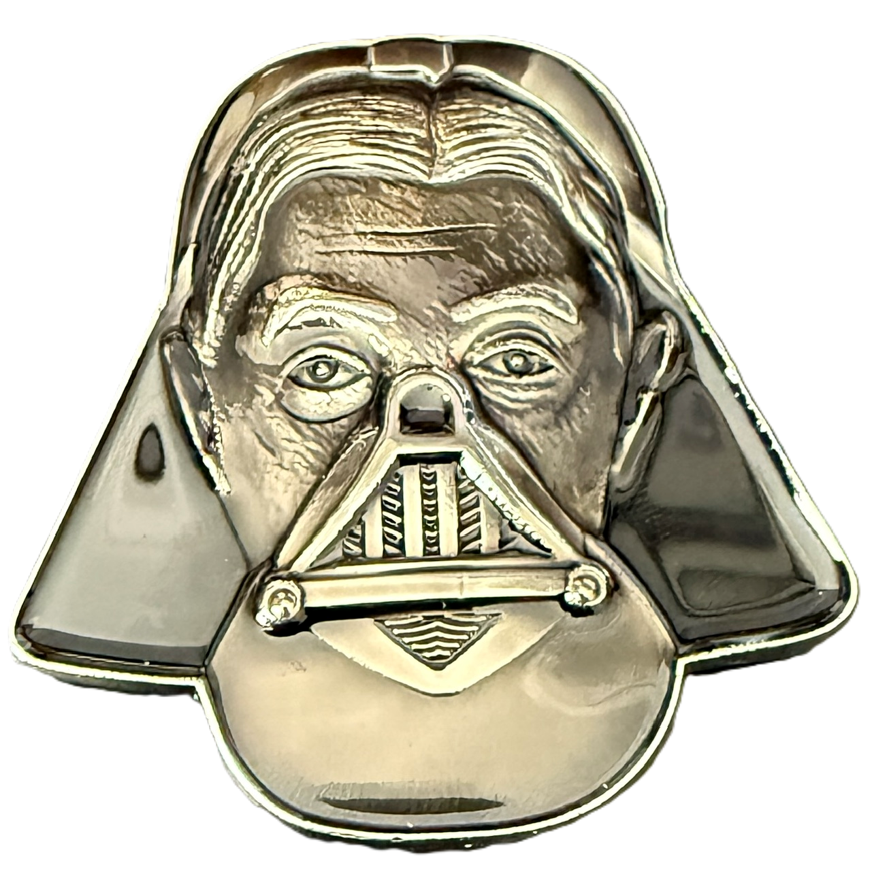

Good of the Order
Darth Rickover Award
  Brian Rieck
  For professional achievement in the scouting and recruiting of new members for USSVI and the Appalachian Base, exceptional results in building a new base to nearly 30 members in three months, and for going above and beyond the call to duty in developing relationships that reflect highly on our organization and the ideals it espouses.

Slide 15
Benediction
Heavenly Father:
We are grateful for the privilege of this meeting and serving You. We ask Your protection upon our shipmates who defend and protect us on land and at sea. Grant us safe passage home and set our hearts on fire with the motivation to forward Your mission until we meet again. Amen!

Slide 16
Adjourned
Next Meeting
09 MAY 2026 1400 HRS
AmVets Post 5, Bristol, VA
Appalachian Base: 830 Minga Rd., Kingsport, TN 37663 | Appalachian.Base.USSVI@gmail.com | (423) 398-1778
Commander: Ron Bennett | R1Bennett@Outlook.com | (512) 535-1773
Vice Commander (PoC): Brian Rieck | SaxMusicGospel@Yahoo.com | (423) 384-4464
Secretary (TOOLS): John Harmon | John@MarionCS.com | (276) 685-3601
Treasurer: David Allen | DAllen3939@Gmail.com | (541) 244-0209
Chaplain: Jes Sutton | JesSutton@Hotmail.com | (423) 342-7169

Slide 17
Appendix
USSVI Appalachian Base Membership Meeting

Slide 18
Zoom Protocols
Remote Attendees will see just the presentation and are muted during the meeting
Cannot participate in ice breakers, 50/50, or other in-person activities
Making a Motion, Point of Order, Question, or Discussion (Members Only)
  Raise Zoom hand – Secretary will monitor, proxy the request to have the floor, and unmute when the Commander gives them the floor
  The remote member will state their motion, ask their question, or participate in a discussion
  Secretary will mute them upon giving up the floor
Voting (Members Only)
  When voting in the affirmative, raise Zoom hand when Commander asks for Ayes; similarly, when voting in the negative
  Secretary will count votes from remote members and report to the Commander

Slide 19
Tolling of the Boats
Date | Boat | Loss
05 JAN 1944 | USS Scorpion (SS-278) | 77 shipmates lost
10 JAN 1943 | USS Argonaut (SS-166) | 102 shipmates lost
12 JAN 1945 | USS Swordfish (SS-193) | 89 shipmates lost
20 JAN 1942 | USS S-36 (SS-141) | no loss of life
24 JAN 1942 | USS S-26 (SS-131) | 46 shipmates lost
Shipmates, rest your oars

Slide 20
Tolling of the Boats
Date | Boat | Loss
04 FEB 1945 | USS Barbel (SS-316) | 81 shipmates lost
11 FEB 1942 | (1st) USS Shark (SS-174) | 59 shipmates lost
16 FEB 1943 | USS Amberjack (SS-219) | 72 shipmates lost
26 FEB 1944 | USS Grayback (SS-208) | 80 shipmates lost
29 FEB 1944 | USS Trout (SS-202) | 81 shipmates lost
Shipmates, rest your oars

Slide 21
Tolling of the Boats
Date | Boat | Loss
03 MAR 1942 | USS Perch (SS-176) | 6 shipmates captured as PoW
05 MAR 1943 | USS Grampus (SS-207) | 71 shipmates lost
12 MAR 1920 | USS H-1 (SS-28) | 4 shipmates lost
15 MAR 1943 | USS Triton (SS-201) | 74 shipmates lost
20 MAR 1945 | USS Kete (SS-369) | 87 shipmates lost
25 MAR 1915 | USS F-4 (Skate) (SS-23) | 21 shipmates lost
26 MAR 1944 | USS Tullibee (SS-284) | 79 shipmates lost
26 MAR 1945 | USS Trigger (SS-237) | 89 shipmates lost
Shipmates, rest your oars

Slide 22
Tolling of the Boats
Date | Boat | Loss
03 APR 1943 | USS Pickerel (SS-177) | 74 shipmates lost
08 APR 1945 | USS Snook (SS-279) | 84 shipmates lost
10 APR 1963 | USS Thresher (SSN-593) | 129 shipmates lost
18 APR 1944 | USS Gudgeon (SS-211) | 79 shipmates lost
20 APR 1926 | USS S-49 (SS-160) | 4 shipmates lost
22 APR 1943 | USS Grenadier (SS-210) | 4 shipmates captured as PoW
24 APR 1988 | USS Bonefish (SS-582) | 3 shipmates lost
Shipmates, rest your oars

Slide 23
Tolling of the Boats
Date | Boat | Loss
03 MAY 1945 | USS Lagarto (SS-371) | 86 shipmates lost
22 MAY 1968 | USS Scorpion (SSN-589) | 99 shipmates lost
23 MAY 1939 | USS Squalus (SS-162) | 26 shipmates lost
29 MAY 1958 | USS Stickleback (SS-415) | no loss of life
Shipmates, rest your oars

Slide 24
Tolling of the Boats
Date | Boat | Loss
01 JUN 1944 | USS Herring (SS-233) | 83 shipmates lost
12 JUN 1943 | USS R-12 (SS-89) | 42 shipmates lost
14 JUN 1944 | USS Golet (SS-361) | 82 shipmates lost
18 JUN 1945 | USS Bonefish (SS-223) | 85 shipmates lost
19 JUN 1942 | USS S-27 (SS-132) | no loss of life
20 JUN 1941 | USS O-9 (SS-70) | 33 shipmates lost
26 JUN – 04 JUL 1943 | USS Runner (SS-275) | 78 shipmates lost
Shipmates, rest your oars

Slide 25
Tolling of the Boats
Date | Boat | Loss
04 JUL 1944 | USS S-28 (SS-133) | 49 shipmates lost
26 JUL 1944 | USS Robalo (SS-273) | 81 shipmates lost
30 JUL 1942 | USS Grunion (SS-216) | 70 shipmates lost
Shipmates, rest your oars

Slide 26
Tolling of the Boats
Date | Boat | Loss
06 AUG 1945 | USS Bullhead (SS-332) | 84 shipmates lost
13 AUG 1944 | USS Flier (SS-250) | 78 shipmates lost
24 AUG 1944 | USS Harder (SS-257) | 79 shipmates lost
26 AUG 1949 | USS Cochino (SS 345) | 7 shipmates lost (1 lost on Cochino) (6 sailors lost from Tusk during rescue)
Shipmates, rest your oars

Slide 27
Tolling of the Boats
Date | Boat | Loss
01 SEP 1920 | USS S-5 (SS-110) | no loss of life
09 SEP 1943 | USS Grayling (SS-209) | 76 shipmates lost
25 SEP 1925 | USS S-51 (SS-162) | 33 shipmates lost
25 SEP 1943 | USS Pompano (SS-181) | 77 shipmates lost
28 SEP 1943 | USS Cisco (SS-290) | 76 shipmates lost
Shipmates, rest your oars

Slide 28
Tolling of the Boats
Date | Boat | Loss
03 OCT 1944 | USS Seawolf (SS-197) | 100 shipmates lost
07 OCT 1943 | USS S-44 (SS-155) | 56 shipmates lost
11 OCT 1943 | USS Wahoo (SS-238) | 80 shipmates lost
12 OCT 1943 | USS Dorado (SS-248) | 77 shipmates lost
17 OCT 1944 | USS Escolar (SS-294) | 82 shipmates lost
24 OCT 1944 | (2nd) USS Shark (SS-314) | 87 shipmates lost
24 OCT 1944 | USS Darter (SS-227) | no loss of life
25 OCT 1944 | USS Tang (SS-306) | 78 shipmates lost
29 OCT 1923 | USS O-5 (SS-66) | 3 shipmates lost
Shipmates, rest your oars

Slide 29
Tolling of the Boats
Date | Boat | Loss
07 NOV 1944 | USS Albacore (SS-218) | 85 shipmates lost
08 NOV 1944 | USS Growler (SS-215) | 86 shipmates lost
16 NOV 1943 | USS Corvina (SS-226) | 82 shipmates lost
16 NOV 1944 | USS Scamp (SS-277) | 83 shipmates lost
19 NOV 1943 | USS Sculpin (SS-191) | 63 shipmates lost (12 killed in action prior to sinking; 30 killed in the sinking; 1 killed in captivity; 20 captured as PoW and died)
Shipmates, rest your oars

Slide 30
Tolling of the Boats
Date | Boat | Loss
02 DEC 1943 | USS Capelin (SS-289) | 76 shipmates lost
10 DEC 1941 | USS Sealion (SS 195) | 5 shipmates lost
17 DEC 1917 | USS F-1 (SS-20) | 19 shipmates lost
17 DEC 1927 | USS S-4 (SS-109) | 40 shipmates lost
Shipmates, rest your oars

Slide 31
Tolling of the Boats
Date | Boat | Loss
02 DEC 1943 | USS Capelin (SS-289) | 76 shipmates lost
10 DEC 1941 | USS Sealion (SS 195) | 5 shipmates lost
17 DEC 1917 | USS F-1 (SS-20) | 19 shipmates lost
17 DEC 1927 | USS S-4 (SS-109) | 40 shipmates lost
Shipmates, rest your oars

Slide 32
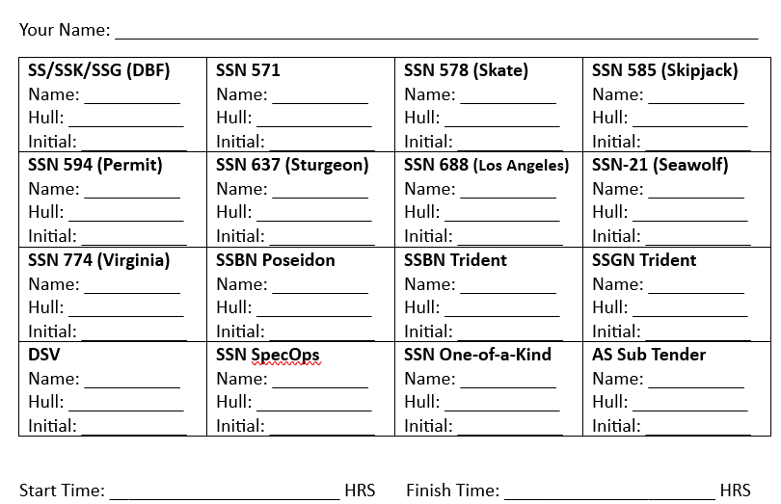
Blue Nose Ice Breaker
Instructions
  Fill up your bingo card by finding shipmates that served on each class of boats
  Write their last name and the hull number they served on
  Have the shipmate initial in the square
First one to give the Commander a completed card wins
After 15 minutes, time will be called and the one with the most filled in squares will be the winner
Prize: Five (5) 50/50 Tickets

Slide 33
Action Items
Item | Assignment | Due | Status
Deploy Remote Meeting Technology (Zoom) | Secretary | 18 APR | Completed
Develop Base Web Site Phase 1 | Web Master | 18 APR | In Progress
Submit more than 2 logos for member vote | Logo Committee | 18 APR | Completed
Volunteers – Open Positions | All | 18 APR | In Progress
Donations – Multiple Items | All | 18 APR | Completed
Pay Base Dues | All | 31 MAY | In Progress

Slide 34
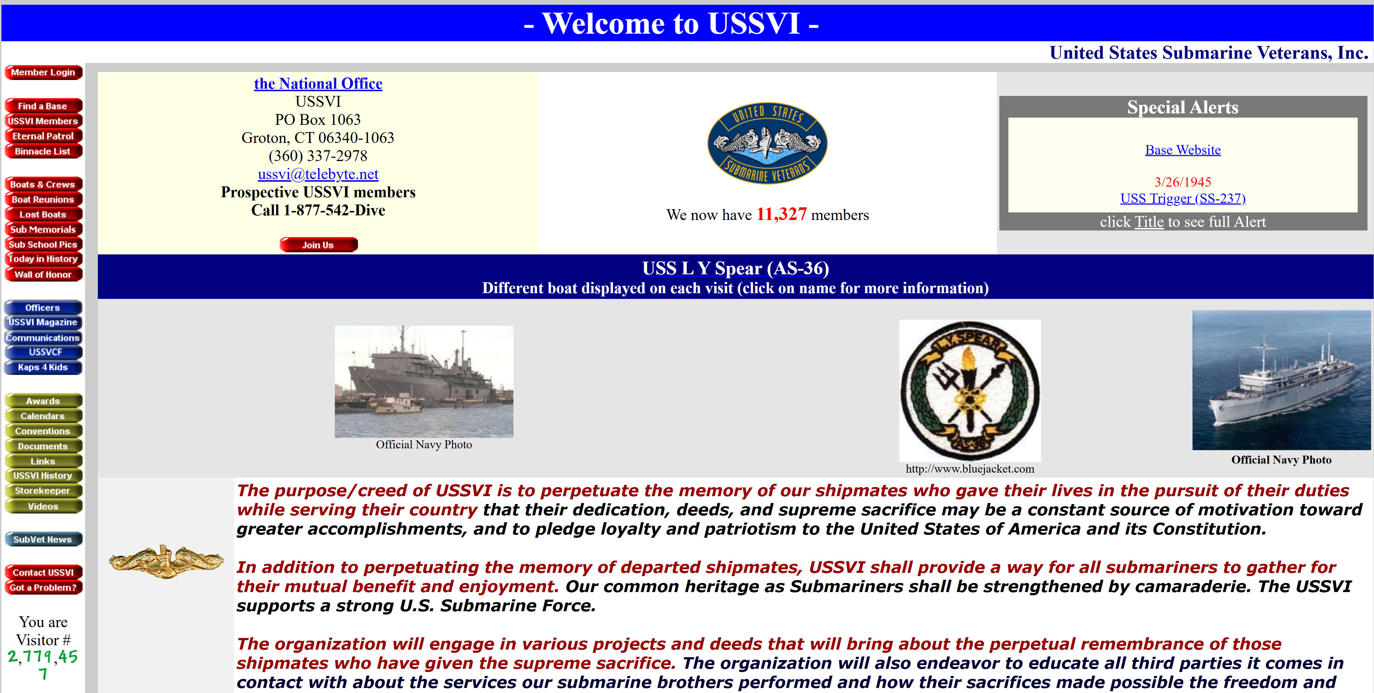
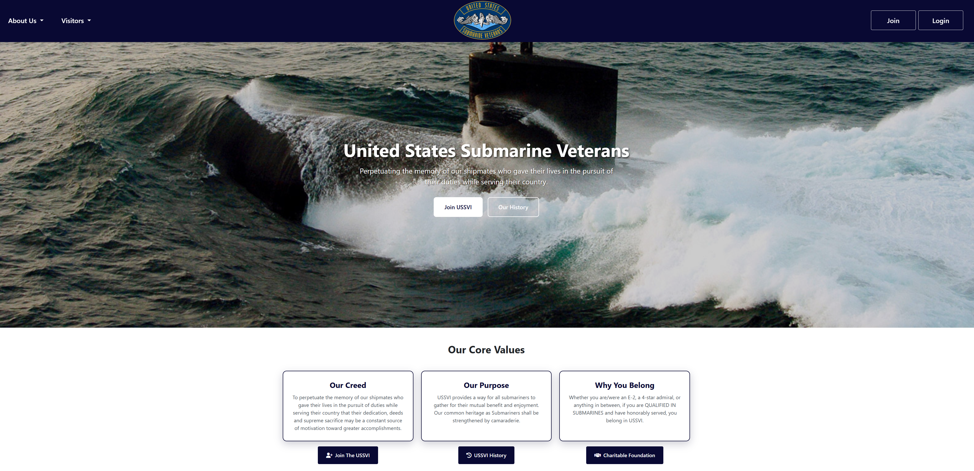
National Web Site
Before
After

Slide 35
Binnacle List
None

Slide 36
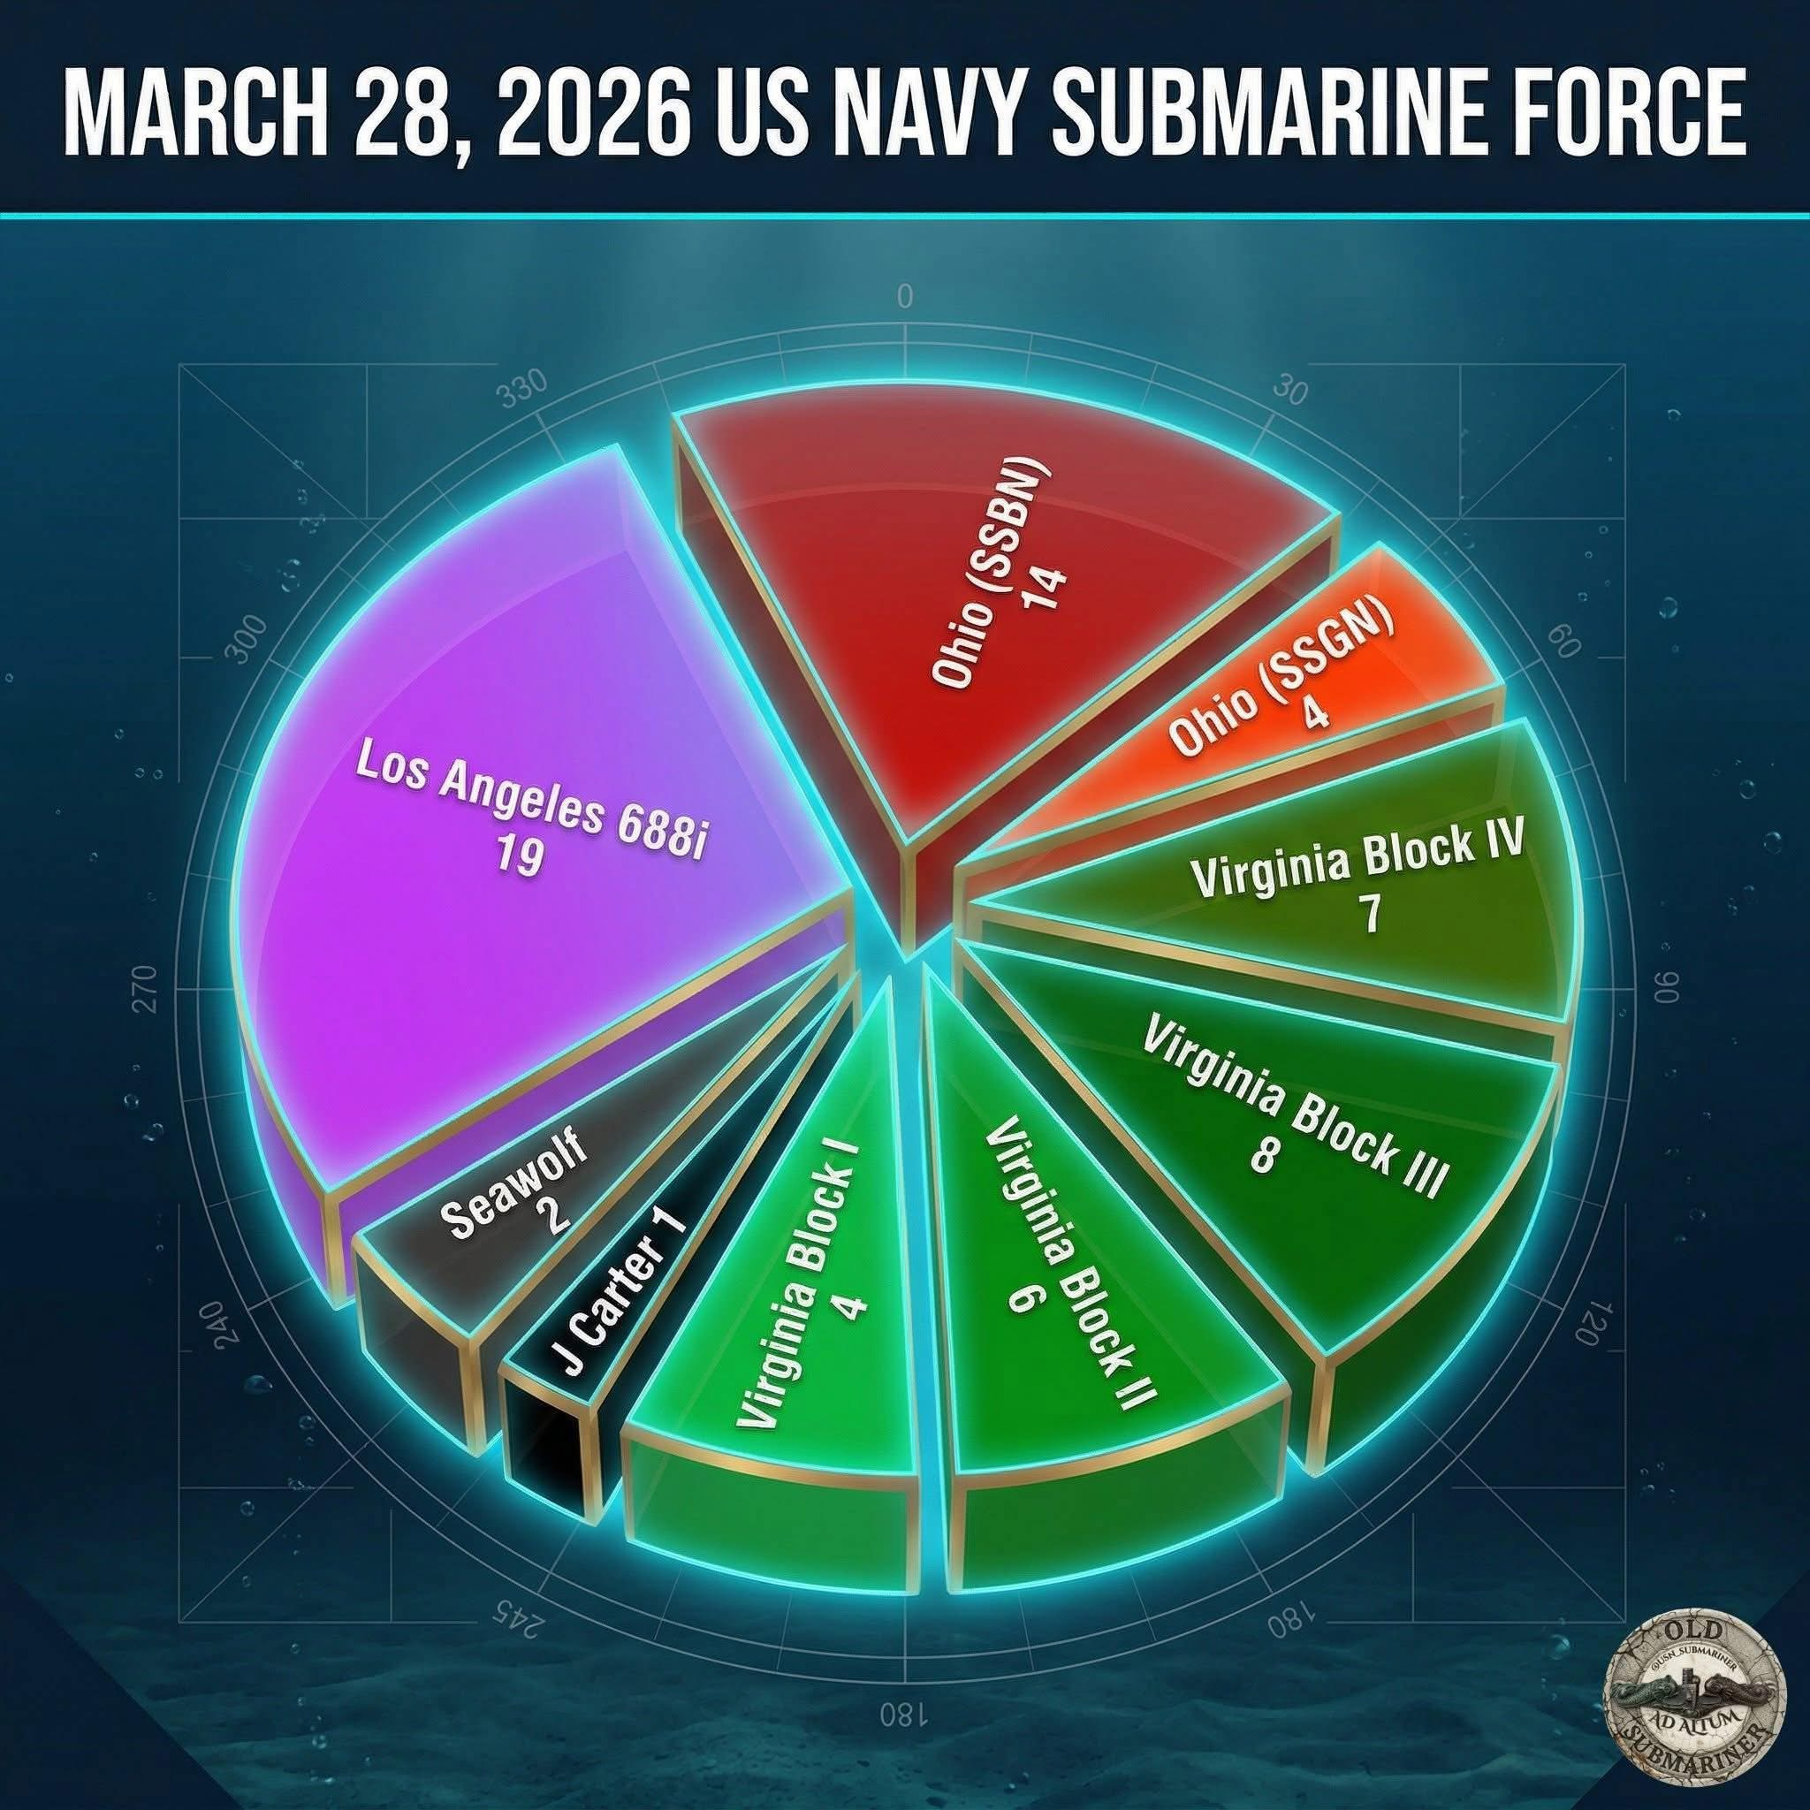
Strength

Slide 37
Base Logo Ground Rules
Logo Committee submitted more than two (2) logos, per the carried motion
Base members will vote on one, and only one, logo
The logo with the most votes will become the base logo
There will be no vote or discussion about modifying any of the logos
  The logos submitted by the Logo Committee will be voted on as-is, with no modifications
  Members had an opportunity to serve on the Logo Committee to have their inputs heard
  Those on the Logo Committee were free to submit what they saw fit
Voting will be by a show of hands
  The Secretary will count the vote for each logo, including those on Zoom
  Please, only vote for one logo

Slide 38



Base Logo
#1
#2
#3

Slide 39
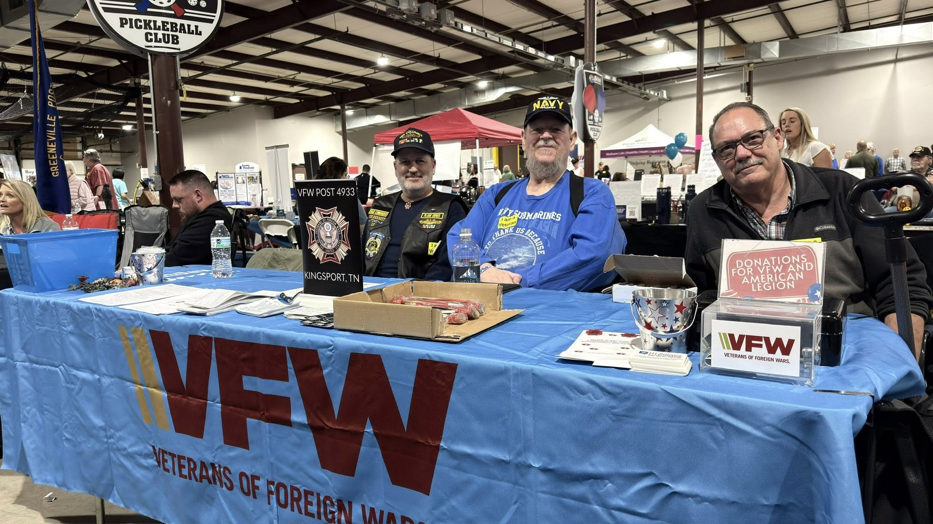
Veteran’s Fair

Slide 40
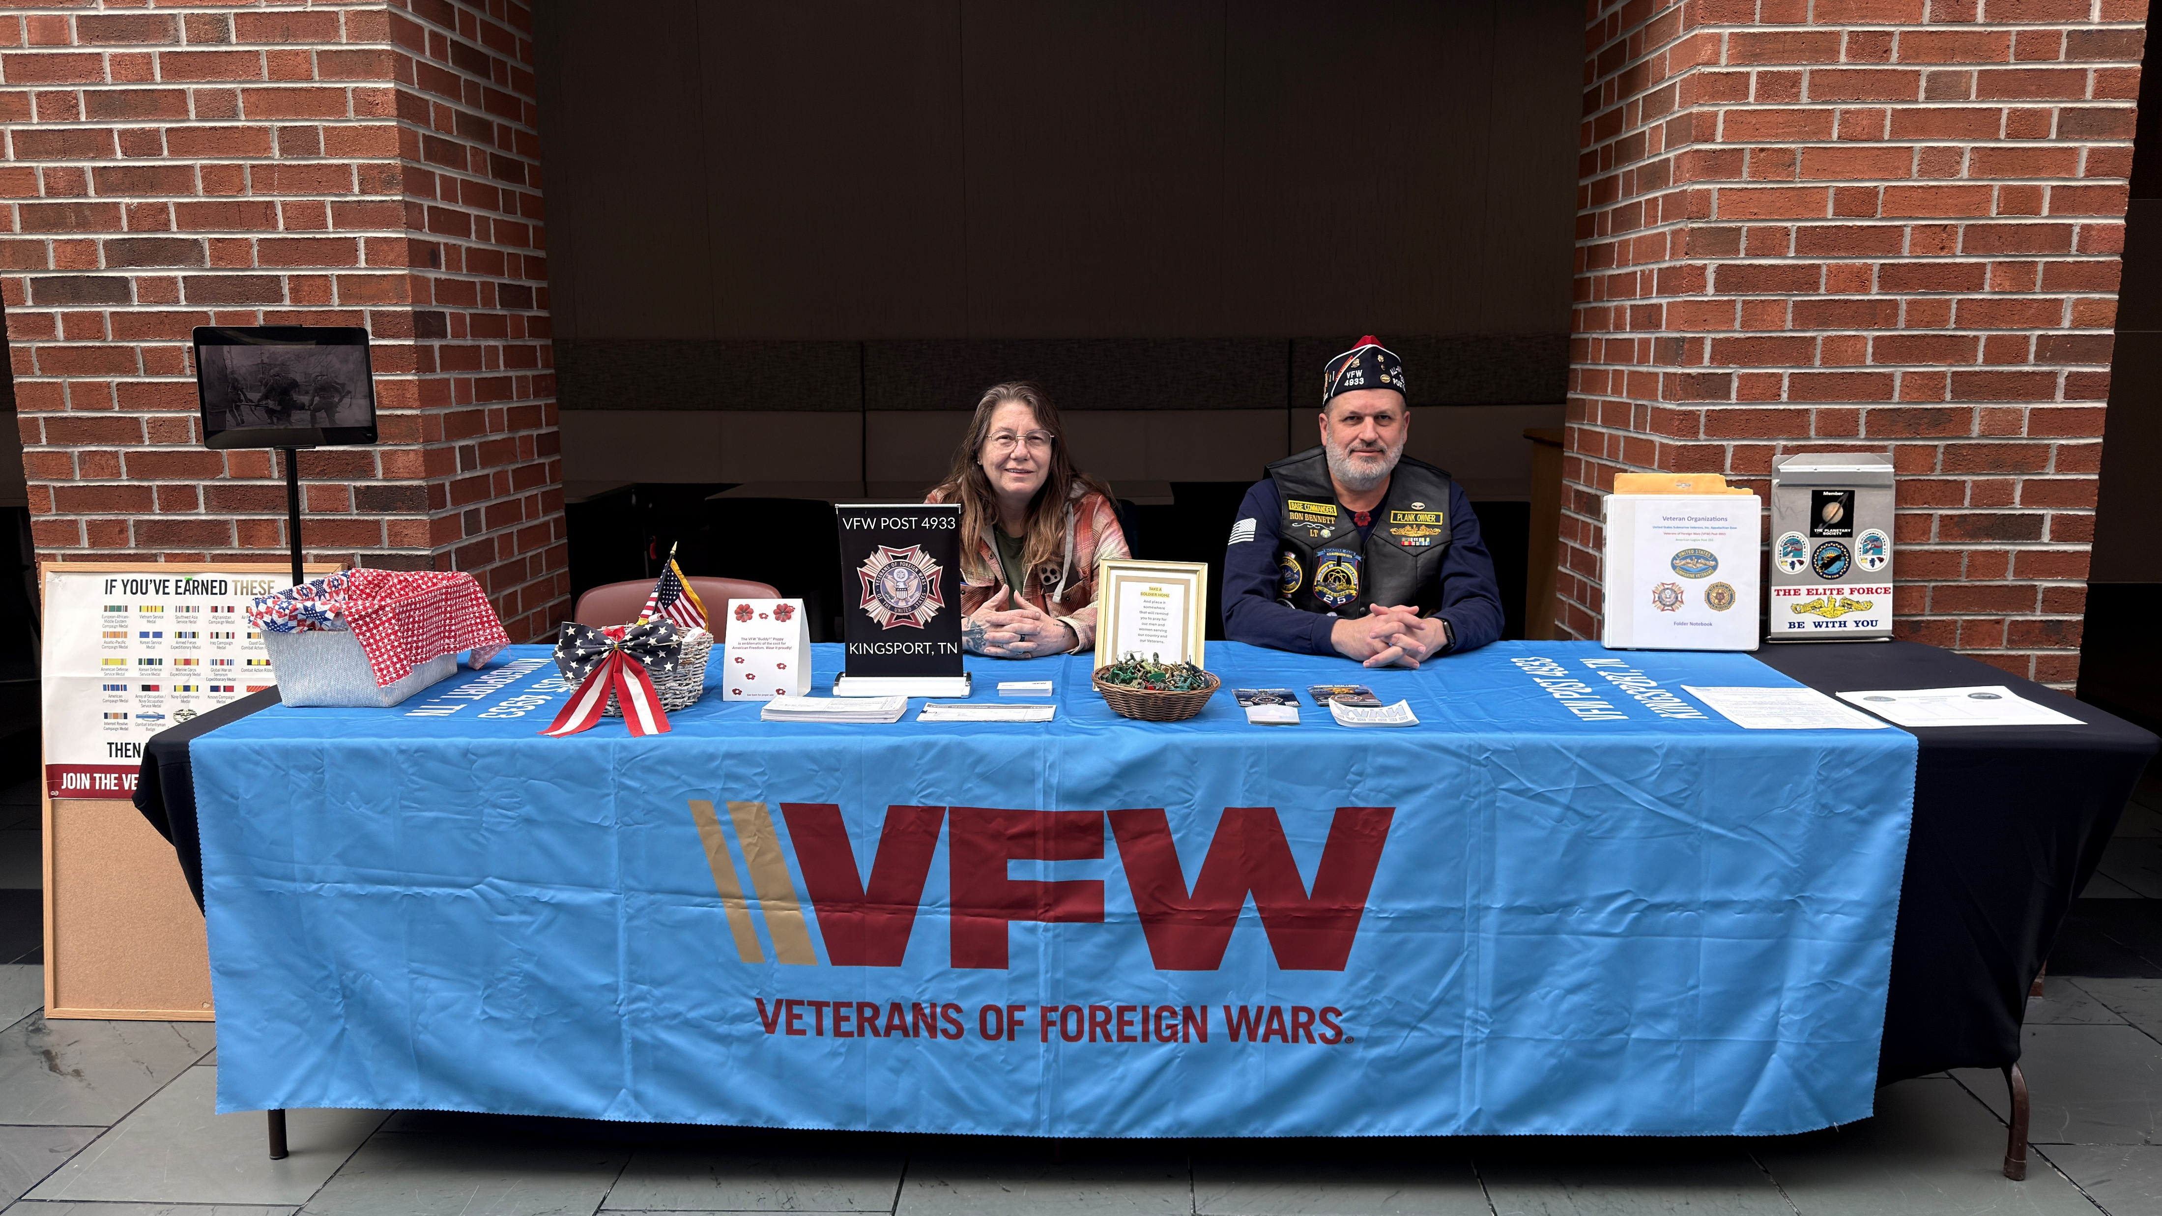
VA Mountain Home

